Slide 1



LASAGNE digitaL frAmework for SmArt Grid and reNewable Energies WP3 : Coordination platform and digital twins
ERA-NET 108767
SFOE 810008657
Giovanna Di Marzo Serugendo
Philippe Glass

Slide 2


WP3 – Objectives / Deliverables / Milestones
WP3 Objectives
Developing a digital framework for collaborative learning among GEDs.
Developing a collaborative ML approach among the different data sources and computational units.
To address this problem, we use a coordination model that provides a coordination media and mechanisms, allowing the GEDs (via intelligent digital twins) to exchange information, about production/consumption, and to collectively and in a decentralised manner smoothly reach varied objectives linked to context-aware/self-adaptive applications.
WP3 Aim
Defining collaborative, distributed ML algorithms providing robust predictions of power usage/production. They rely on coordination middleware and intelligent digital twins providing support for distributed interactions specific to smart grids.

Slide 3
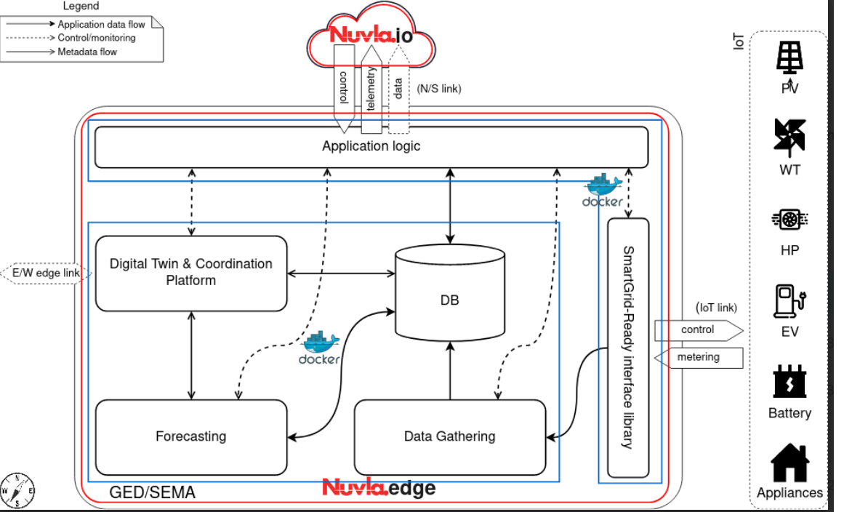
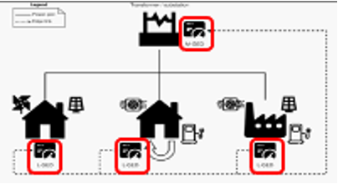
WP3 – Objectives / Deliverables / Milestones
Deliverables
D3.1: Design of distributed collaborative learning methods
D3.2: Coordination model and middleware extended with distributed algorithms and mechanisms specific to smart grids. Design of digital twins.
D3.3: Implementation of distributed collaborative learning. Implementation of intelligent digital twins.
Milestones
M3: The context-aware, self-adaptive "flexibility & power trading/aggregation" application developed and deployed on an experimental edge-to-cloud architecture

Slide 4

WP3 - Status - DONE
Coordination model and platform
Available and running
Uses real data from Les Vergers
Digital twins (producer, consumer, regulator, learning agent)
Available and running, interacting through the coordination platform
Algorithms - energy :
Energy contracts (wattage, no pricing) among producers, consumers
Peak shaving among producers, consumers, regulator
Preparation of a light version for Grid Edge device
Gossip-based federated learning throw platform
Experimented with Markov Chains and LSTM
Can be generalized to any model
Interactions among multiple platforms
One node
Multiple node (four) in P2P fashion

Slide 5
Gossip-Based Federated Learning with coordination platform
aggregation + spreading => Gossip
Preliminary experiments with Markov chain and LSTM
Learning agent
Learning agent
Tuples space
Tuples space
LSA
LSA
LSAext
LSAext
Eco-Laws
Eco-Laws
Bonding
❄
Bonding
❄
❄
Spreading
❄
Spreading
Decay
Decay
❄
❄
Aggregation
❄
Aggregation
❄
❄
❄
Gossip
Gossip

Slide 6
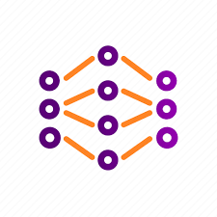








Gossip Federated Learning : zoom on a Grid Edge Device
GED 1
GED 2
GED n
Neighbouring Edge Devices
Learning twin
Learning
Model
Learning twin
Learning
Model
Learning twin
Learning
Model
…
Coordination platform
Coordination platform
Coordination platform
W$j$^{k,1}
…
W$j$^{k,2}
W$j$^{k,n}
GED 1,2, … n Learning model weights
GED k Model weights
GED k Model weights
GED k Model weights
GED 1 Model weights
GED 2 Model weights
GED N Model weights
GED k
Aggregation applied to leaning model weights:
Spreading
W$j$^{k}
W$j$^{k,1}
W$j$^{k,2}
W$j$^{k,n}
All GED learning models have the same structure.
W_{j+1}^{k}
Aggregation mechanism
Bonding
Each GED manages model distribution and aggregation.
Decay
Model weights
W_{j}^{k}
Coordination platform
Mechanism generalised to any model : aggregation functions defined in learning model
Learning twin
Learning
Model

Slide 7
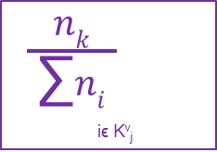
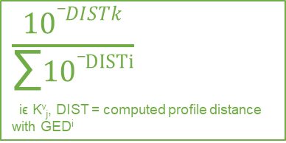
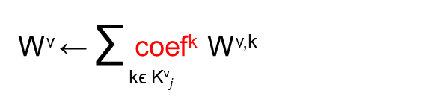
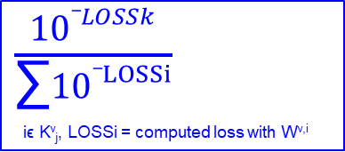
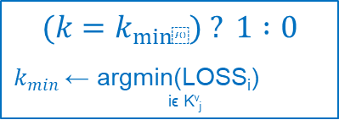
The different aggregation functions used
W^{v} ← ∑ coef^{k} W^{v,k}
kϵ K^{v}$j$
Power profile
Number of samples
Power Loss
Min loss
$\frac{nk}{\begin{aligned}\text{∑}ni \\ \end{aligned}}$
iϵ K^{v}_{j}
$\frac{10_DISTk}{\begin{aligned}\text{∑}10_DISTi \\ \end{aligned}}$
iϵ K^{v}_{j}, DIST = computed profile distance with GED^{i}
$\frac{10_LOSSk}{\begin{aligned}\text{∑}10_LOSSi \\ \end{aligned}}$
iϵ K^{v}_{j}, LOSSi = computed loss with W^{v,i}
$$(k=k_{min⁡}) ? 1 :0$$
$k_{min}$ ← argmin(LOSS_{i})
iϵ K^{v}_{j}
Quantitative approach
Approach based on the power profile similarities
Approach based on model loss
Approach based on the minimal model loss
a model which contains more samples in training data should be more accurate.
a model from a node which contains a more similar power profile should be more accurate.
how the node model prediction is similar to the validation values (use the validation data set).
the metamodel composed with the different received models does not perform that the single model that minimises the loss value.

Slide 8
Gossip Federated Learning : experimentation
Model applied on single GEDs and GEDs clusters
Experimentations with Markov chains and LSTM models
Use of topologies with 2 and 4 GEDs
Comparison of 4 different aggregators : sampling number, power loss, min loss, GED power profile

Slide 9
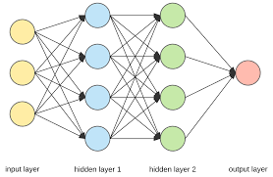
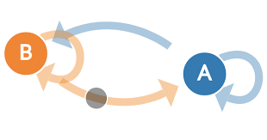
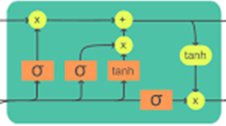
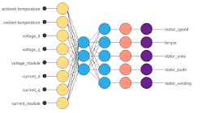
Gossip-Based Ensemble Learning with coordination platform
GED-1 Learning
model
GED-2 Learning
model
GED-n Learning
model
…
calculation of predictions
GED-1 Prediction
GED-2 Prediction
GED-n Prediction
Coordination platform
Coordination platform
Coordination platform
GED 1
GED 2
GED n
Prediction
Prediction
Prediction
GED k
Spreading
Aggregation applied to predictions:
GED-k Prediction
GED-1 Prediction
GED-2 Prediction
GED-n Prediction
GED-k Prediction
Aggregation mechanism
Bonding
GEDs can have different learning model type.
Decay
Coordination platform
GED-k Prediction
Each EGD manages model distribution and aggregation.
GED-k Learning
model

Slide 10
Gossip Ensemble Learning : experimentation
Model applied on a single GED and on a GEDs cluster
Experimentations with Markov chains on GED-1 and LSTM models on GED-2
Comparison of 2 different aggregators : last power and power history

Slide 11

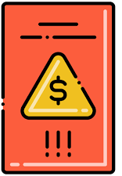




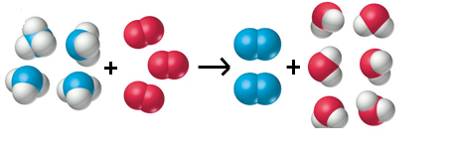

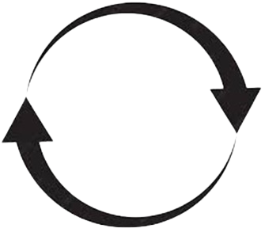



Social acceptability : scenario with awards (badge)
Regulator twin
Prosumer-1
(Free-rider)
Prosumer-2
(altruist)
Energy
Transaction
Coordination laws
Award/penalty attribution to prosumers based on:
- ability to limit consumption
- energy contribution
- equity in energy distribution
Prosumer-3
(altruist)
Coordination model
Prosumer
2
Prosumer
3
Use of awards in energy transactions

Slide 12




Refresh of GED neighbour links
When starting-up the coordination platform: register the GED address an external database (name + IP + port).
GED 5
Link refresh loop :
GED 6
Step 1 - add link to isolated GEDs
GED 6
Step 2 - retrieve of all GED power profiles received from neighbourhood
GED 4
Step 3 - compute all GED distances (use similarity function of power profile)
GED 7
Step 4 - add links to nearby GEDs
(GED distance <= max_value)
GED 1
Step 5 - remove links to GEDs that are distant more than 5 consecutive times
(GED distance < max_value)
GED 2
GED 3
some GEDs can be isolated. (too far from anther GED)

Slide 13
WP3 - Status (TODO)
Social acceptance by design (use of the WP2 project's findings)
Introduce the notion of fairness/equity, and considerer it in the algorithms of negotiation and contract generation
Introduce gamification =>get users more involved
Design a recovery plan in case of shortage => makes users feel more confident
Game theory-based contracts
Mechanism of offers evaluation, based on several criterion related to personal/social welfare.
Mechanism of negotiation
for bilateral negotiations.
for multilateral negotiations in organised market (as Dutch auction)
Use the theory of Nash equilibrium to optimise the likelihood to succeed a negotiation
P2P interactions / Interactions among multiple platforms
Generalisation from 4 nodes to any number, any topology
Use Electricity living-lab data?

Slide 14

Questions
Progress report, February 2024

Slide 15
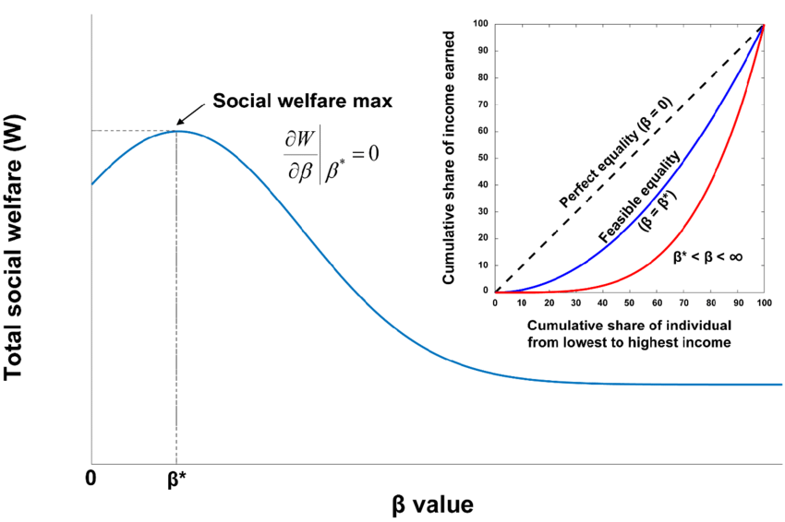

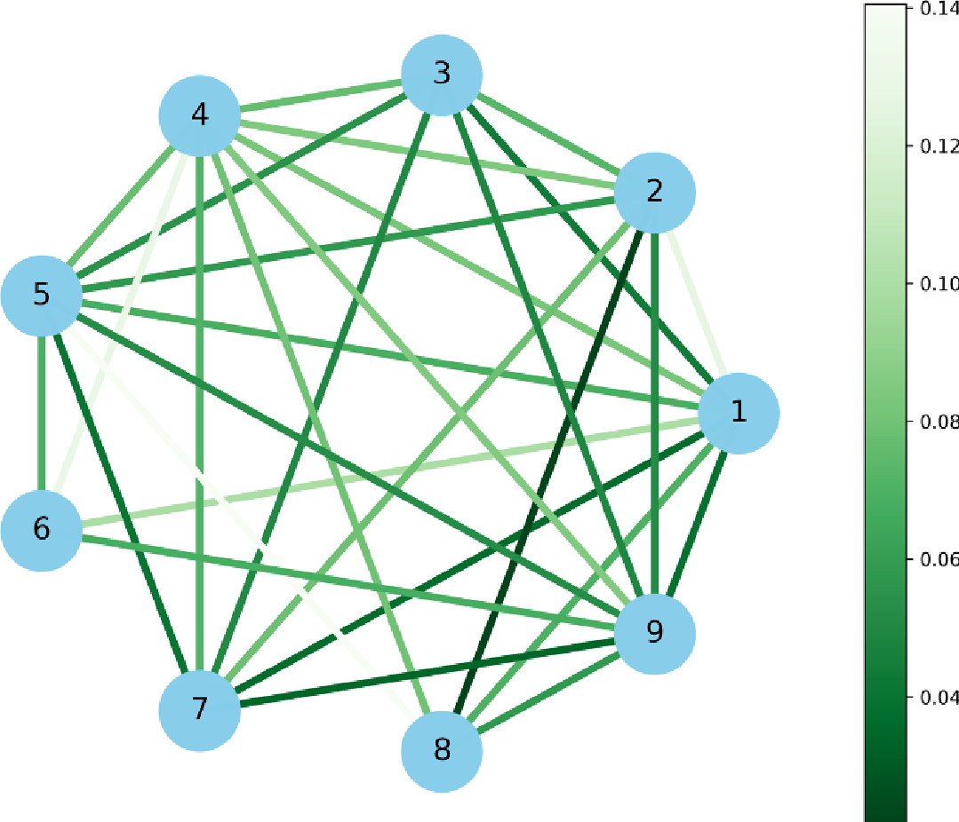
Strategy of negotiation (gaming, auctions, ..)
Mechanism of contract/negotiation by integrating welfare criterion
=> evaluate function for each criteria
Modeling of agent’s utility function
Agent #i : Profile = {λ¹_{i}, λ²_{i}, ….. , λ^{p}_{i}}
Offer: ω
utility: ω -> λ¹_{i}*e¹(ω) + … + λ^{p}_{i} * e^{p}(ω)
U_{i}(ω)
Modeling of bilateral negotiation
Modeling of multilateral negotiation : organized market (auctions)

